Slide 1

Smart Home Network Monitor using DHCP
Teammates CSE BDA V2 :-
1. GAUTAM YADAV(RA2011027010006)
2. SAPRATIBH SHYAM (rA2011027010008)
3. SHLOK SINGH(ra2011027010025)
4. PRINCE AYUSH (ra2011027010028)

Slide 2
ABSTRACT
The main objective of this project is to develop a low-cost secure Home automation system using Dynamic Host Configuration Protocol (DHCP) which can be remotely controlled by a device on any network.
As technology advances, we are seeing the advent of automation even in our daily lives. Modern houses are gradually shifting from conventional switches to centralized control system, involving remote controlled switches.
Presently, most appliances need to be operated in person by user which makes it cumbersome, time wasting and redundant at times. It becomes even more difficult for the elderly or physically handicapped people to do so. Automation system provides an efficient and modern solution to manage this. Here we apply this method to automate our House.
In order to achieve this, a wireless Home Gateway is connected to Servers Via Internet using DHCP so we can operate Devices at home from anywhere, a GUI application on the cell phone sends ON/OFF commands to the receiver to which devices are connected. By using DHCP, the devices can be turned to automate the process of configuring devices on IP networks, thus allowing them to use network services such as DNS, NTP, and any communication protocol based on UDP or TCPON/OFF remotely through devices connected over the Server. Thus, we connect and operate devices over the internet via the Dynamic Host Configuration Protocol.

Slide 3
OBJECTIVES
Our work tries to derive solution providing better security system for the home along with smart control on home appliances with the help of Smart Phone.
This system adds benefits to the traditional residents to : -
Monitor,
Control home appliances,
Save power from anywhere and anytime through Smart Phone,
Age Friendly GUI for elderly and physically handicapped people,
And it is low cost , Reliable and Secure.

Slide 4
SCOPE OF THE PROJECT
Scope for the Home Automation Systems involves making homes even smarter.
Homes can be interfaced with sensors including motion sensors, light sensors, smart door, smart windows, smart fan and smart home intrusion system and provide automated toggling of devices based on conditions.
More energy can be conserved by ensuring occupation of the house before turning on devices and checking brightness and turning off lights if not necessary.
The system can be integrated closely with home security solutions to allow greater control and safety for home owners.
The next step would be to extend this system to automate a largescale environment, such as offices and factories. Home Automation offers a global standard for interoperable products.
Standardization enables smart homes that can control appliances, lighting, environment, energy management and security as well as the expandability to connect with other networks.

Slide 5
INTRODUCTION
With Advancement and uses of Internet Technology, the demand for automation increased drastically.
Security along with efficient power supply is of great concern from small house to large industries in traditional systems.
Constant monitoring of people’s behavior, activities are required for the purpose of protection and management of confidential data.
This system adds benefits to the traditional residents to monitor, control home appliances, and collateral save power from anywhere and anytime through Smart Phone.
With the help of DHCP we can control Home Devices from anywhere using Smart Phone until unless it is connected to internet.

Slide 6
What is DHCP?
Dynamic Host Configuration Protocol (DHCP) is a network management protocol used to automate the process of configuring devices on IP networks, thus allowing them to use network services such as DNS, NTP, and any communication protocol based on UDP or TCP.
A DHCP server dynamically assigns an IP address and other network configuration parameters to each device on a network so they can communicate with other IP networks.
DHCP is an enhancement of an older protocol called BOOTP.
The technology eliminates the need for individually configuring network devices manually, and consists of two network components, a centrally installed network DHCP server and client instances of the protocol stack on each computer or device.

Slide 7
Home automation is the residential extension of "building automation".
It is automation of the:
Home
Housework or
Household activity.
Home automation may include centralized control:
Lighting of entire house
HVAC (heating, ventilation and air conditioning)
Appliances and
Other systems (Like Home Weather Station, digital receptionist, etc)
Home Automation (HA) provide improved convenience, comfort, energy efficiency and security

Slide 8
LITERATURE REVIEW
Year | Author | Title & Volume | Contribution
2005 | Alkar and Buhur | An Internet based wireless home automation system for multi functional devices | Internet-based wireless solution to connect home devices to a slave node is implemented. The test results showed that the wireless communication has limited range less than 100 meters in concrete building.
2007 | Yavuz | IOT Based Home Security | Design and implement a telephone and PIC (programmable interface) remote controlled device for controlling the home electrical devices.
2019 | Gerardus Blokdyk | Agile DHCP a Complete Guide | Co-founder of The Art of Service. Founded in 2000, The Art of Service is a management consultant firm that helps C-level suite executives and their advisors identify their blind spots through books, self-assessment guides and consultations.
2019 | Harsh Kumar Singh and Saurabh Verma | A step towards Home Automation using IOT | NodeMCU (ESP8266) microcontroller along with Relays is used to control electrical switches remotely from the server which is built on Node.js. User can control switches using a Web Application after authenticating.

Slide 9
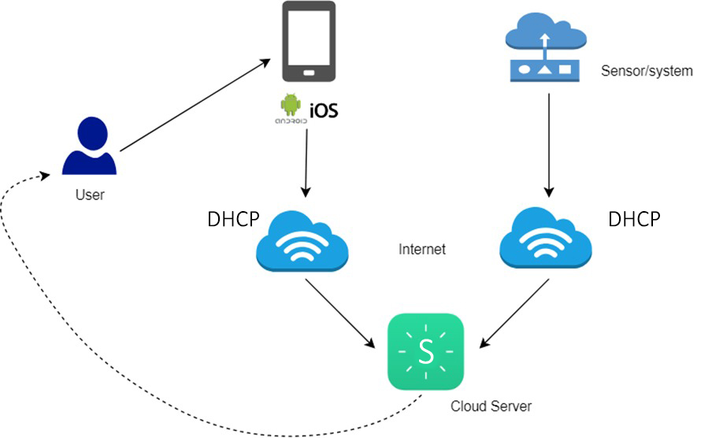
ARCHITECTURE DIAGRAM

Slide 10
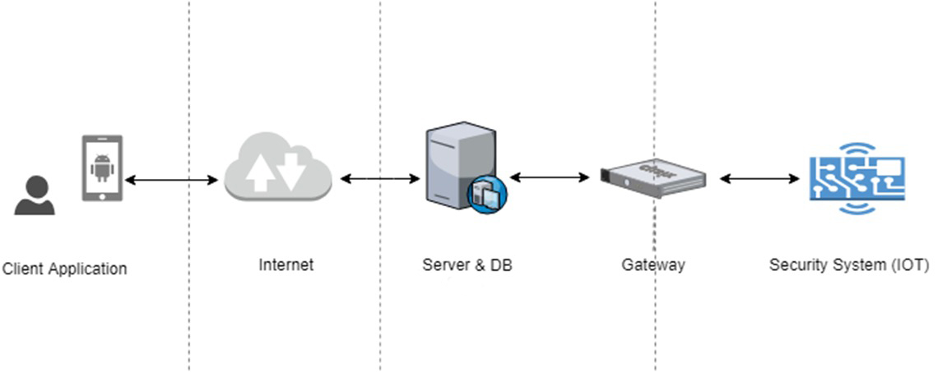

Slide 11
Procedure
Step 1 - Using Cisco Packet Tracer Add Home Gateway to the Home Network
Step 2 - Connect Devices to the Wireless Network and Configure them using DHCP. Click the I/O Config tab and change the Network Adapter Type to the PT-IOT-NM-1W wireless adapter.
Step 3 - Add End User Device to the Network. Click the Config tab and then click the Wireless0 Interface. Change the SSID from Default to Home Gateway. After the network SSID is changed the Tablet should learn an IP address through DHCP within a few seconds.
Step 4 - Configure Devices to register with the Home Gateway server.

Slide 12
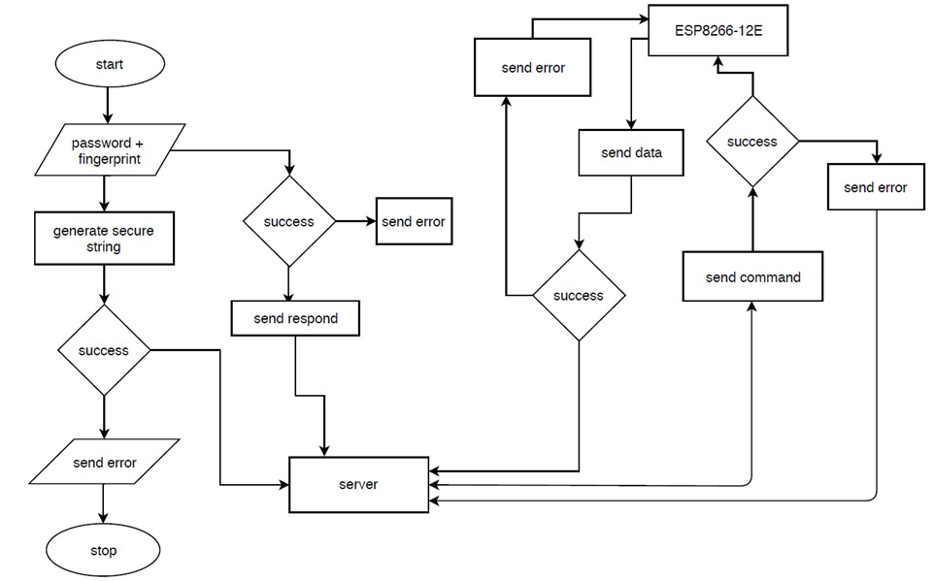
Flow Chart

Slide 13
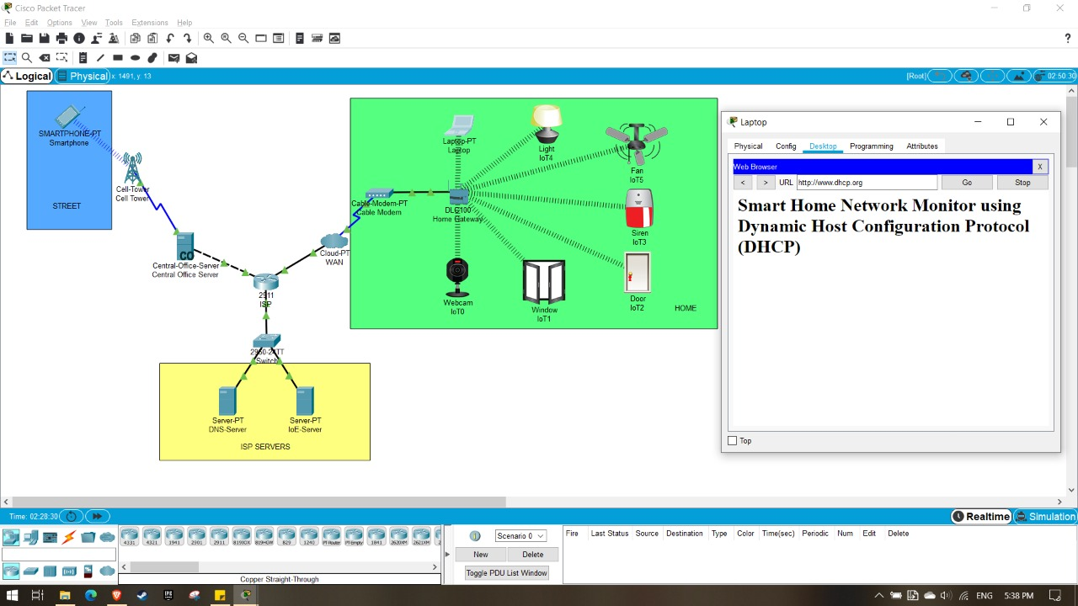
RESULTS
Screenshots:

Slide 14
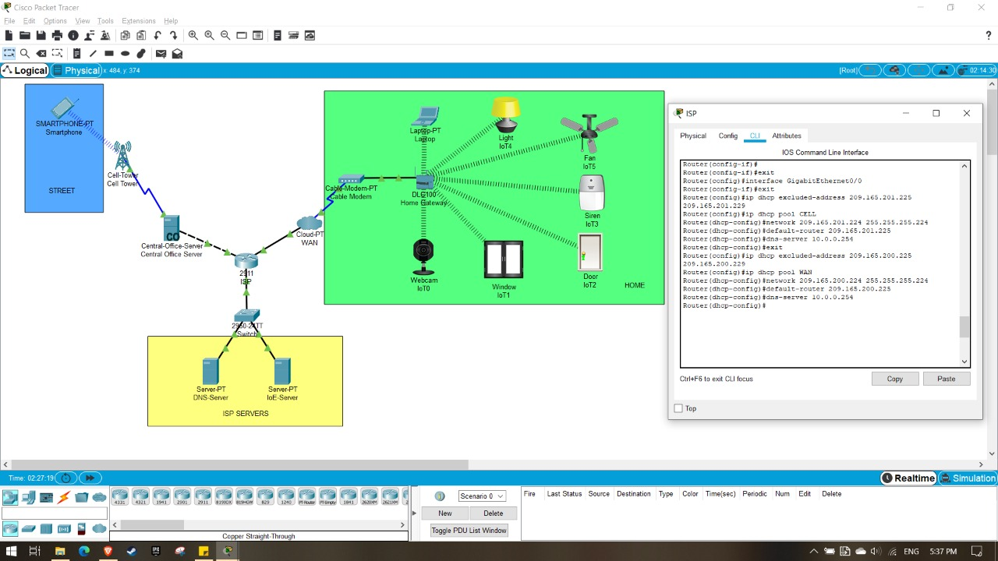
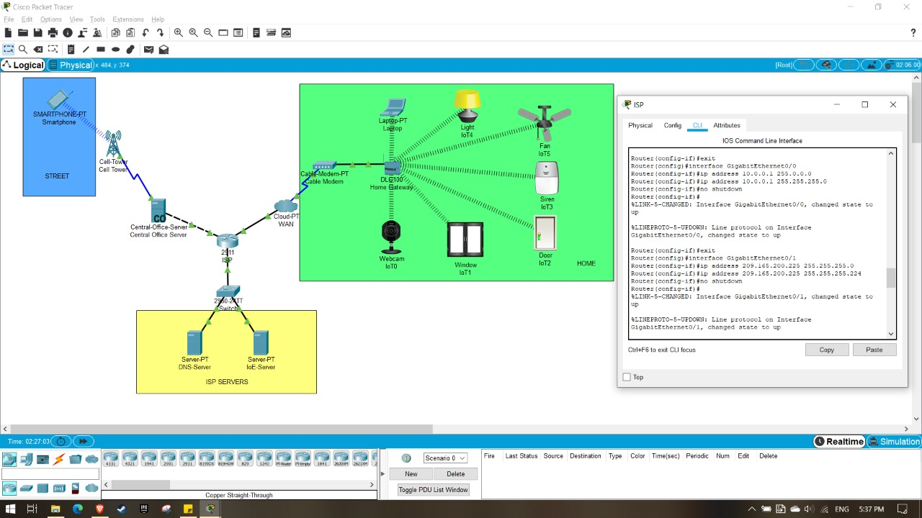

Slide 15

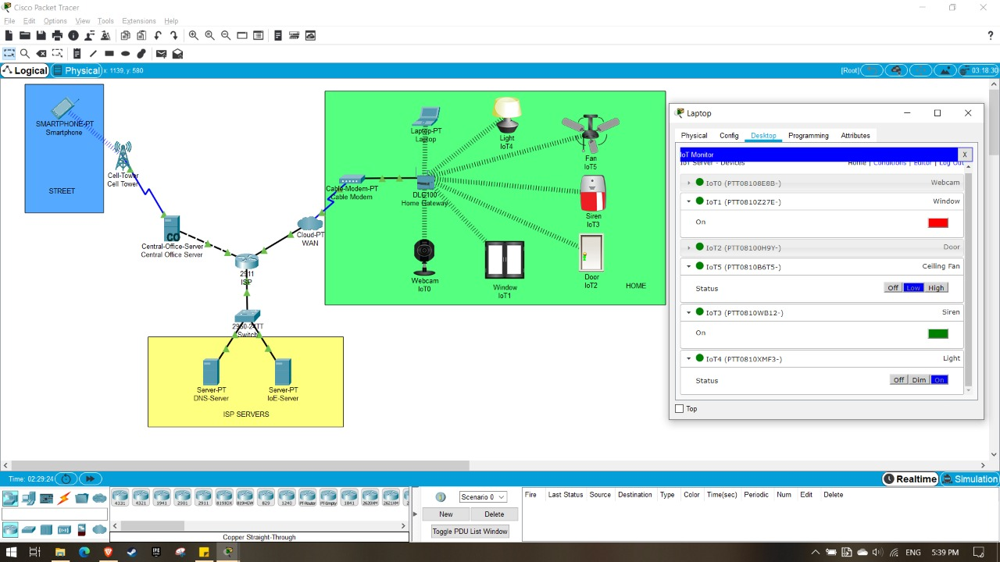

Slide 16
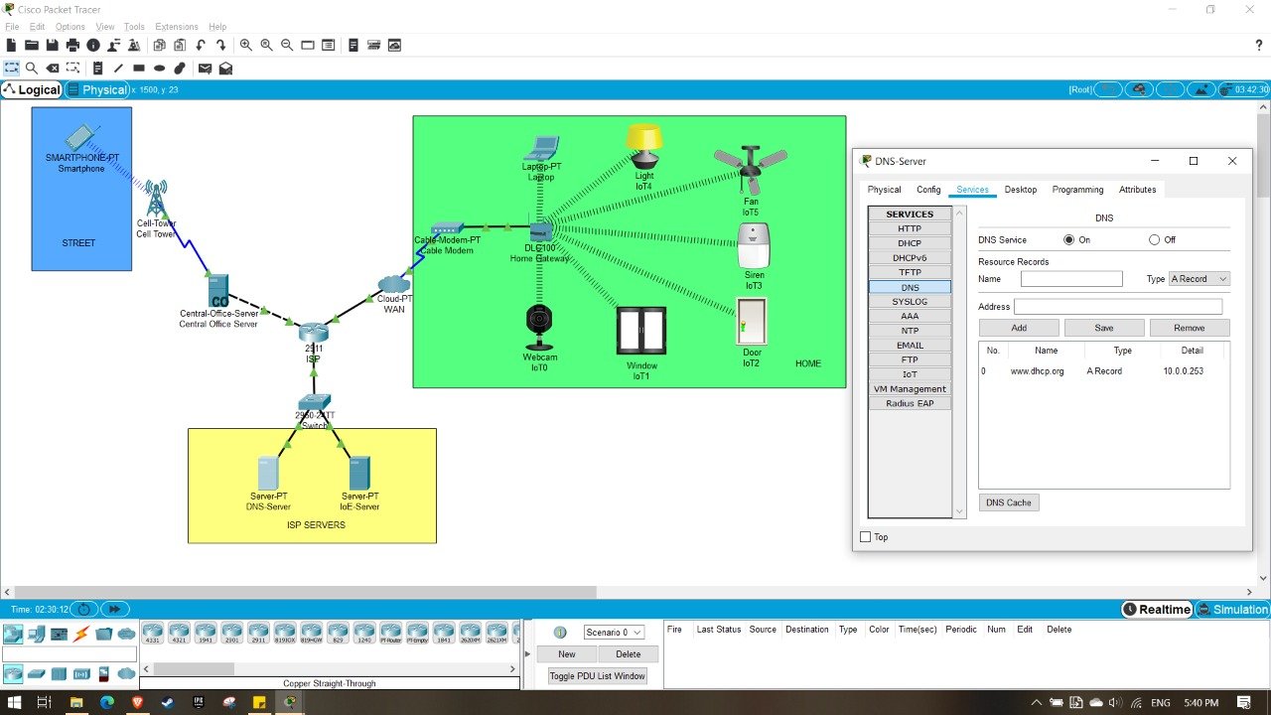
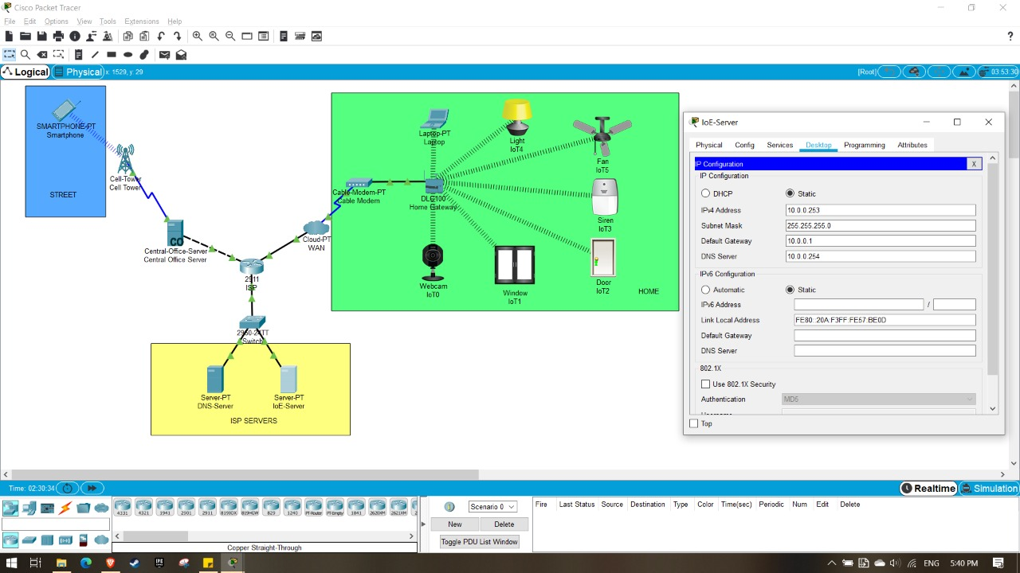

Slide 17
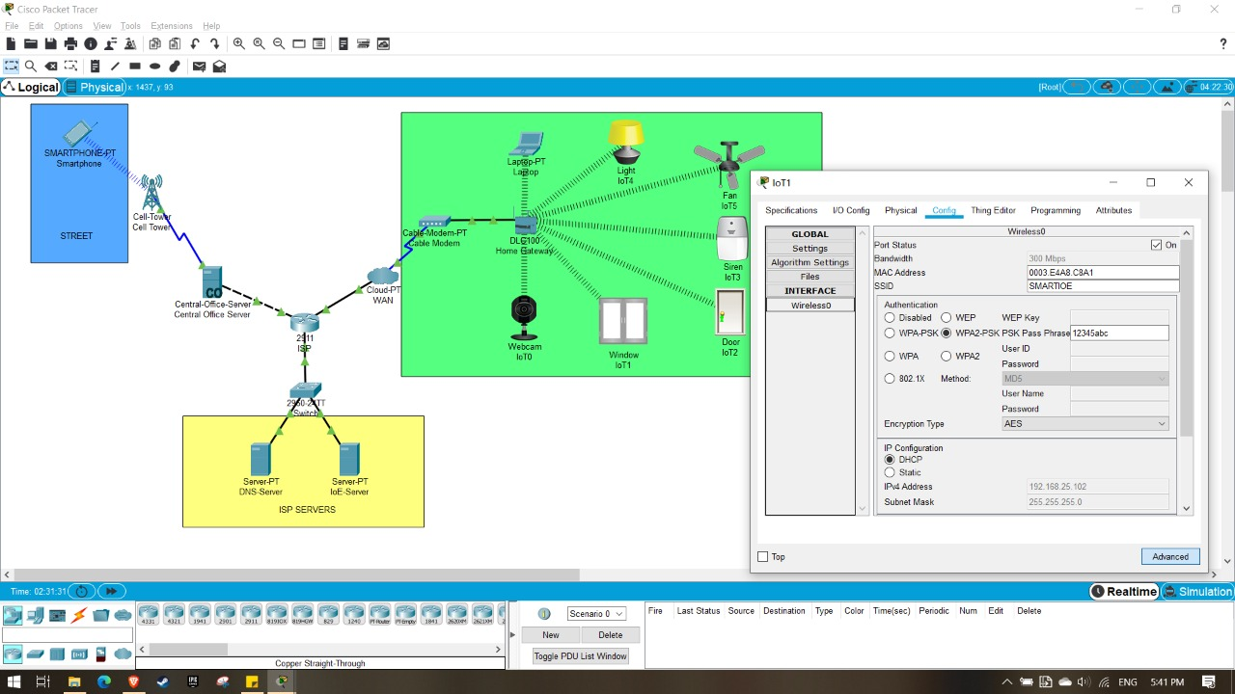
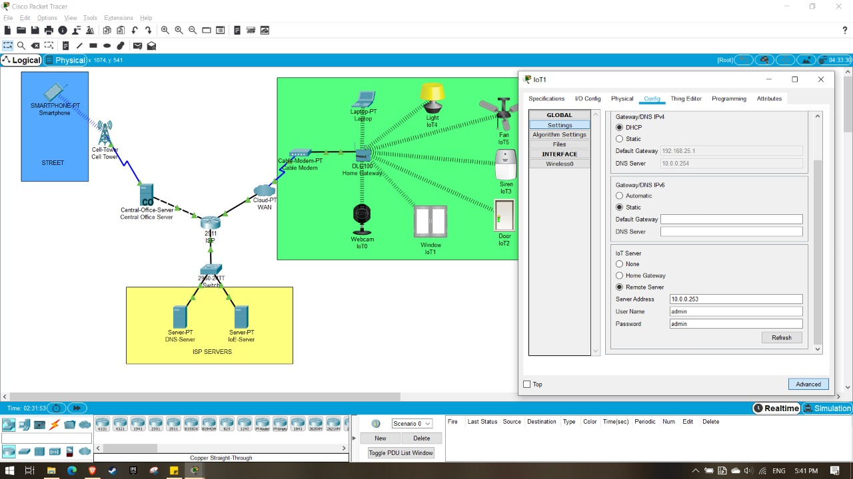

Slide 18
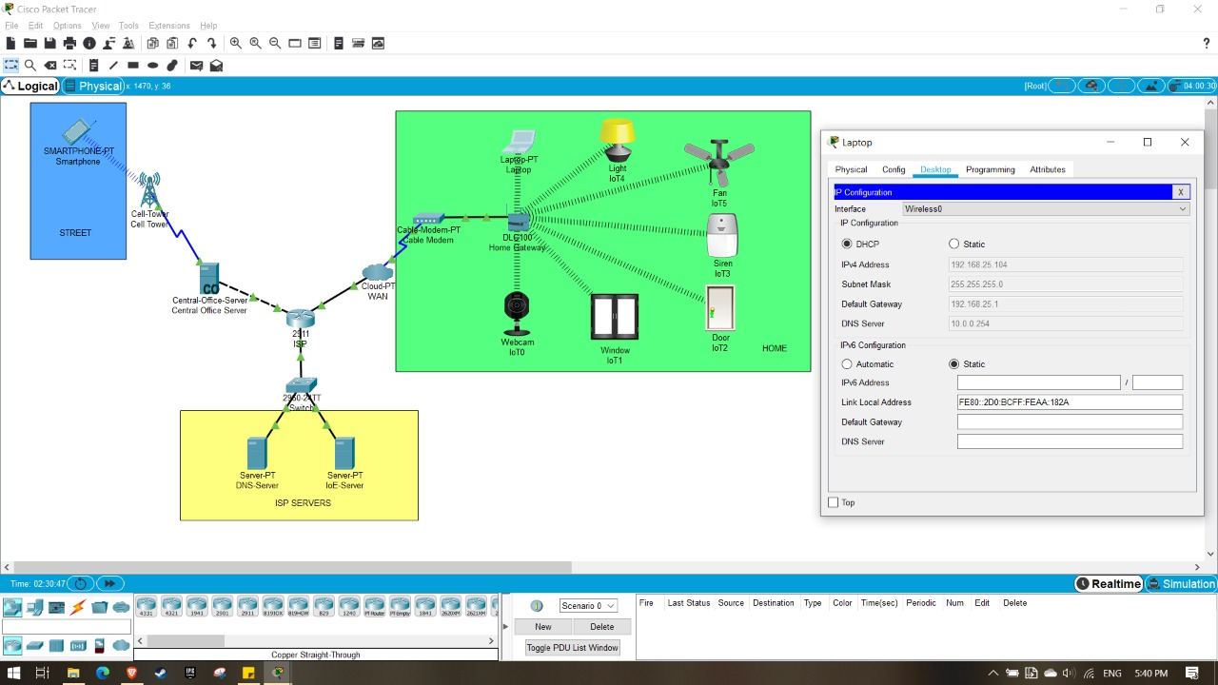
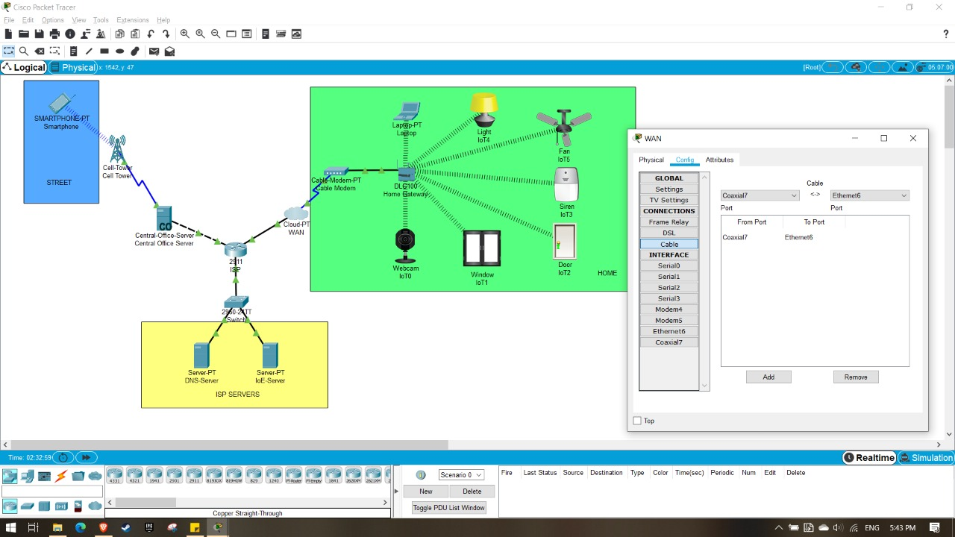

Slide 19
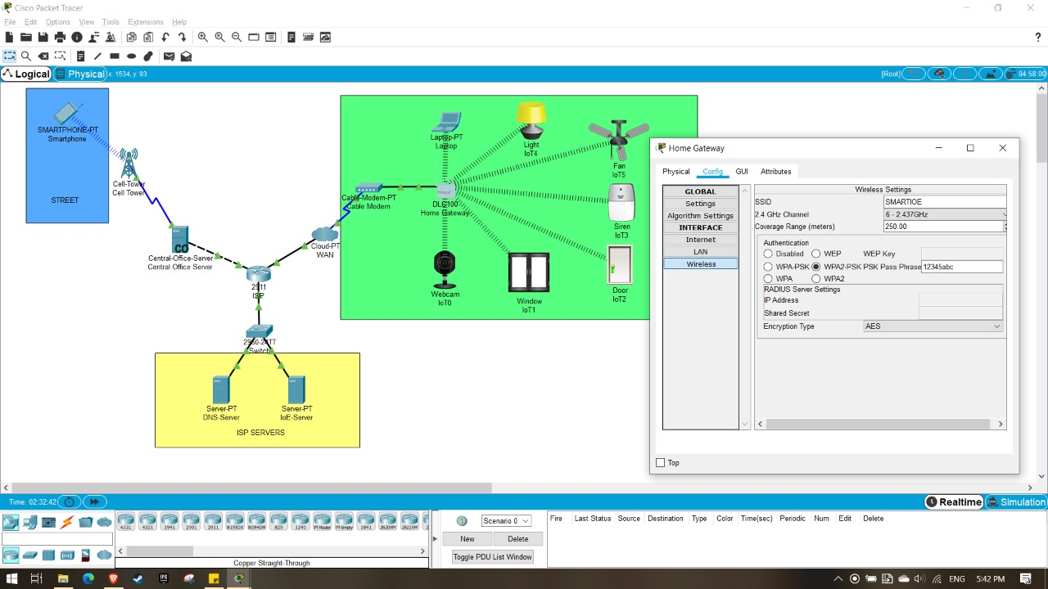
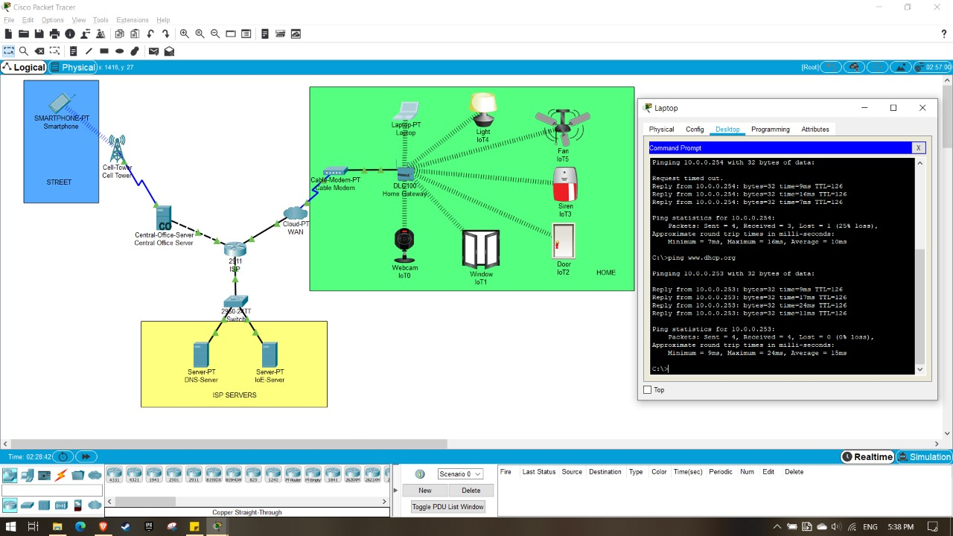

Slide 20
Conclusion
It presents an effective Smart Home Automation module.
Advantages : -
1. Cost effective
2. Practically implementable
3. Eco-friendly
4. Safest way to save energy
5. Secure
Disadvantage :-
1. This module can’t be monitored remotely in the absence of Internet.

Slide 21
REFERENCES
D. Choi, S. Seo, Y. Oh, and Y. Kang, “Two-Factor Fuzzy Commitment for Unmanned IoT Devices Security,” IEEE Internet of Things Journal,vol. 6, no. 1, pp. 335–348, Feb 2019.
M. H. Bhuyan, D. K. Bhattacharyya, and J. K. Kalita, Network Traffic Anomaly Detection and Prevention - Concepts, Techniques, and Tools,1st ed., ser. Computer Communications and Networks Series. Springer International Germany, 2017.
R. Petrolo, V. Loscri, and N. Mitton, “Towards a smart city based on cloud of things, a survey on the smart city vision and paradigms,” Trans. Emerg. Telecommun. Technol., vol. 28, no. 1, pp. 1–12, 2015.
S. P. Tseng, B. R. Li, J. L. Pan, and C. Lin, “An application of internet of things with motion sensing on smart house,” in IEEE International Conférence on Orange Technologies, 2014, pp. 65–68.
S. Das, N. Debabhuti, R. Das, S. Dutta, and A. Ghosh, “Embedded system for home automation using sms,” in IEEE International Conference on Automation, Control, Energy and Systems, 2014, pp. 1–6.
E. Yavuz, B. Hasan, I. Serkan, and K. Duygu, “Safe and secure pic based remote control application for intelligent home,” International Journal of Computer Science and Network Security, vol. 7, no. 5, 2007.
A. Z. Alkar and U. Buhur, “An internet based wireless home automation system for multifunctional devices,” IEEE Transactions on Consumer Electronics, vol. 51, pp. 1169–1174, 2005.

Slide 22
THANK YOU

